Slide 1

Move Your UI to the 23rd Century with Delphi and Skia. Engage!
DELPHICON
2021
The Official Online Conference All About Embarcadero Delphi
delphicon.embarcadero.com
Ian Barker

Slide 2
SET PHASORS TO STUN!
We are going to take a look at the incredibly powerful SKIA graphics library.
We’re going to boldly go and use Skia4Delphi to harness the power of Skia and do some AMAZING things.
And yes, we are going to create our own STARSHIP COMPUTER INTERFACE…
…just because we can

Slide 3


Speaker
Ian Barker
Embarcadero MVP
https://about.me/IanBarker
https://github/checkdigits
https://blogs.embarcadero.com

Slide 4
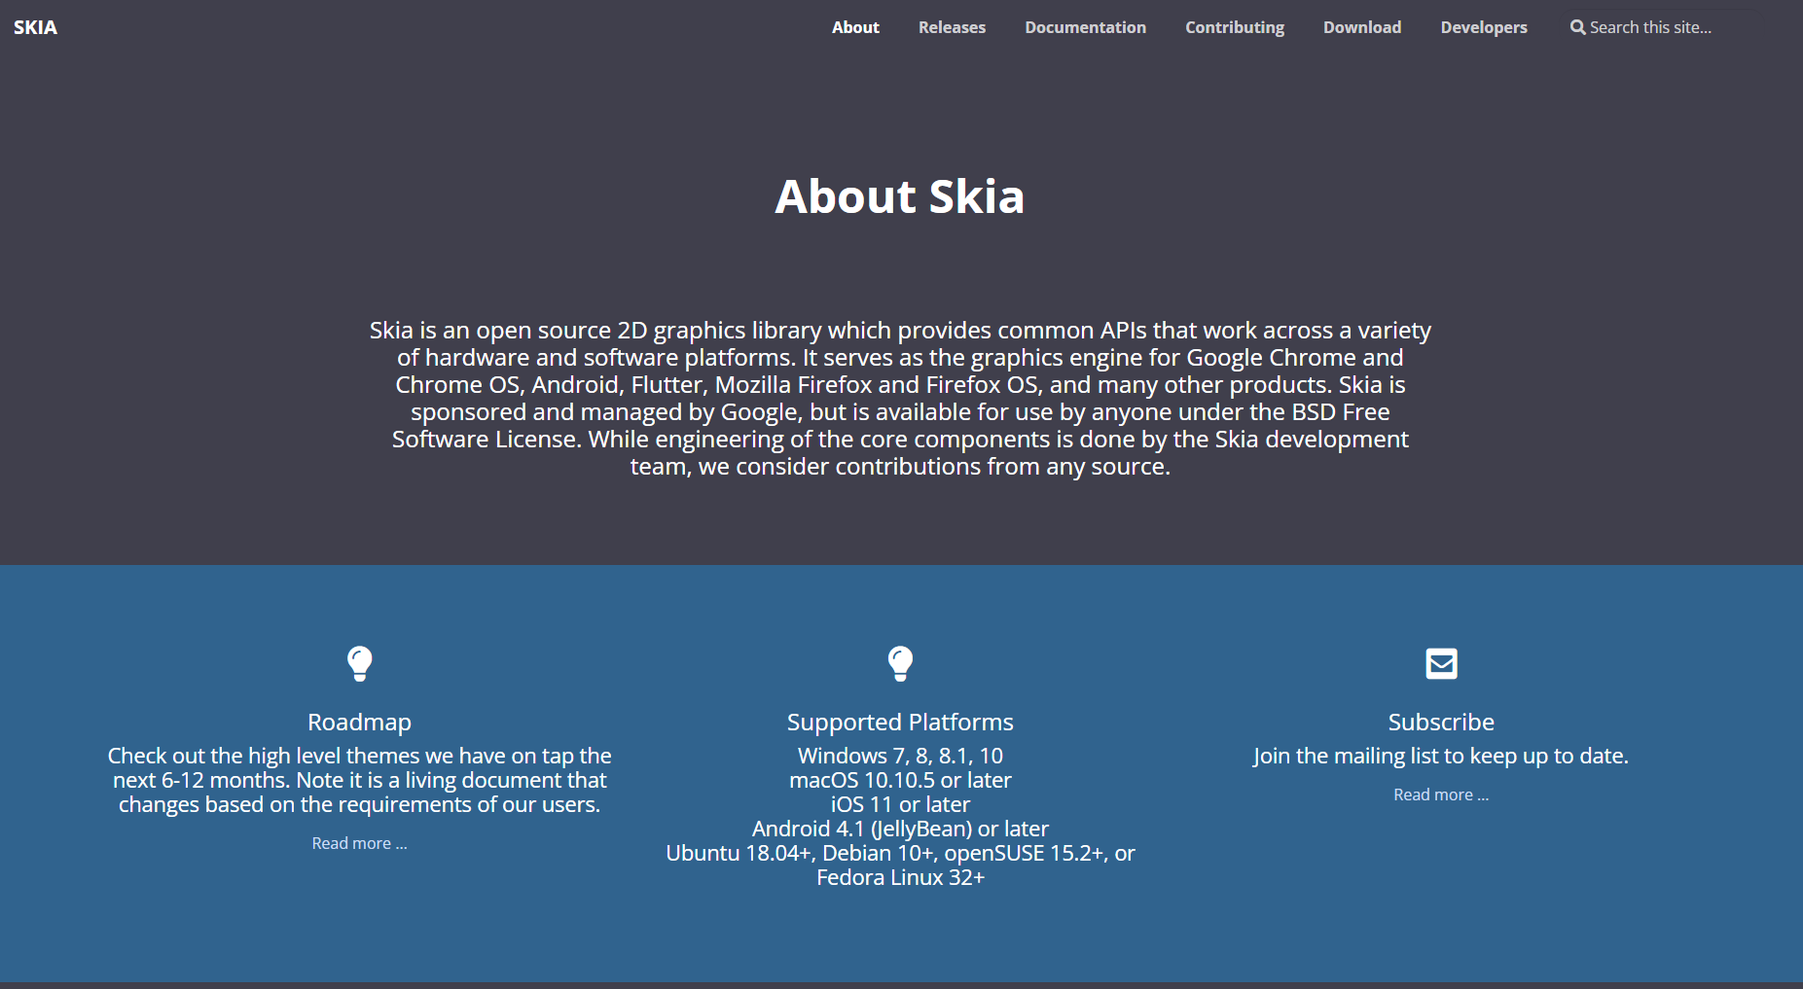
What is Skia?
Find it at www.skia.org
In their words…
“Skia is an open source 2D graphics library which provides common APIs that work across a variety of hardware and software platforms. It serves as the graphics engine for Google Chrome and Chrome OS, Android, Flutter, Mozilla Firefox and Firefox OS, and many other products”

Slide 5
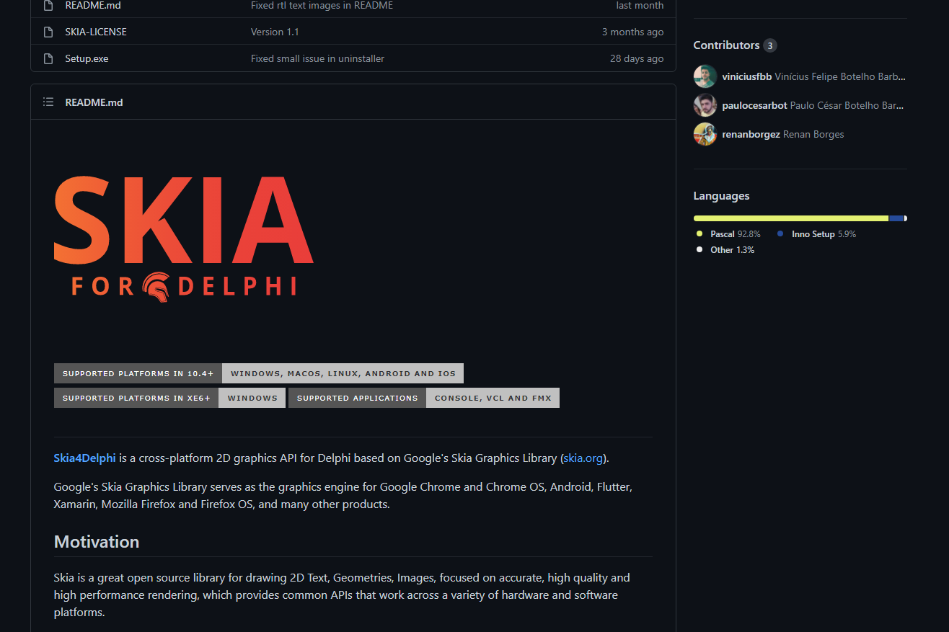
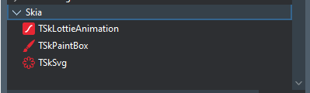
What is Skia4Delphi?
Components and a really well-written library for Skia.
For Delphi XE6 and later
Windows GUI and Console apps (XE6)
Windows, macOS, iOS, Android, Linux (10.4+)
Find it at https://github.com/viniciusfbb/skia4delphi

Slide 6

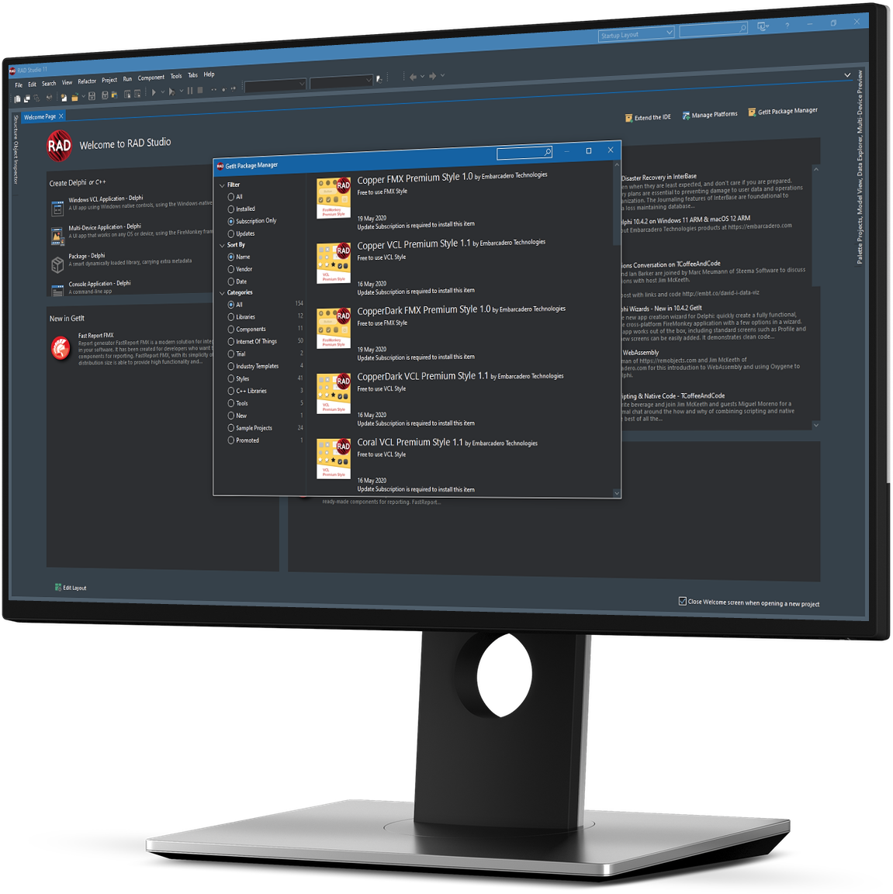

Time for a DEMONSTRATION!

Slide 7
More Information:
Skia web site
www.skia.org
Skia4Delphi
https://github.com/viniciusfbb/skia
My space computer example
https://github.com/checkdigits/spacecomputer
Lottie Animations
https://lottiefiles.com

Slide 8

Ian Barker
Q&A
https://about.me/IanBarker
https://github/checkdigits
https://blogs.embarcadero.com

Slide 9
DELPHICON
2021
The Official Online Conference All About Embarcadero Delphi
delphicon.embarcadero.com

